Slide 1
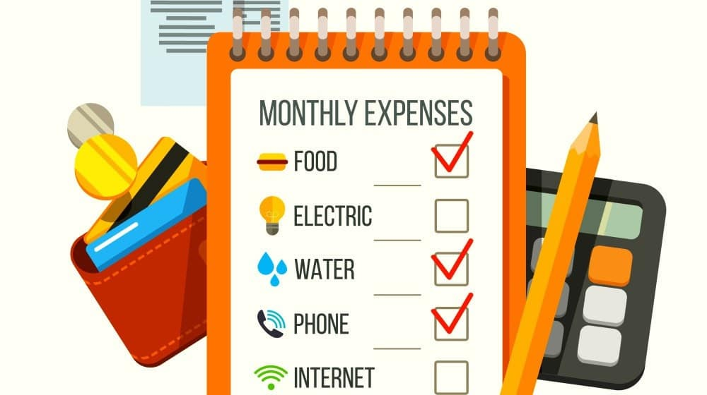
TRACK YOUR SPENDING
A comprehensive Guide to Managing Your Finances

Slide 2
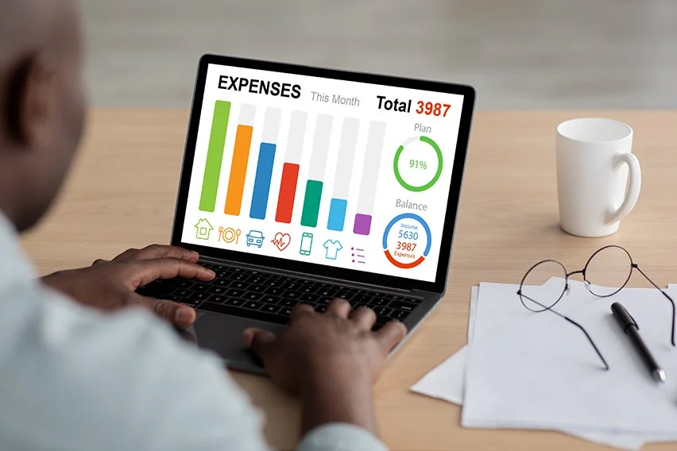
GOAL OF THE PROJECT
The primary objective of this project is to empower individuals to effectively track and manage their personal finances through a user-friendly platform that enables them to:
Create personalized spending lists for both cash and cashless transactions.
Categorize expenses to gain insights into spending patterns.
Set and monitor spending limits for specific categories to maintain financial discipline.
Generate comprehensive reports to analyze spending trends and identify areas for improvement.
Make informed financial decisions based on accurate data.

Slide 3
DATA COLLECTION METHOD
We opted for a manual data entry approach, allowing users to directly input their spending information, including categories, amounts, and dates.
This approach offers flexibility and customization to track personal expenses.
Key Benefits:
Customization: Tailors data input to individual financial habits.
Control: Ensures accuracy and relevance by giving users control over the data.
Accessibility: Suitable for users with varied technical backgrounds and devices.

Slide 4
VISUALIZING & DETAILED EXPENSE TRACKING
The application provides detailed tracking of each transaction (date, category, amount) for precise analysis of spending patterns, helping users make necessary adjustments.
Features:
Transaction History: Displays individual expenses with detailed information.
Search & Filtering: Allows filtering by category, date range, or amount.
Visual Tracking: Dynamically updates graphs as users add expenses, providing a clear view of spending trends relative to set limits.

Slide 5
01
Initial Screen
02
Adding Expense
TABLE OF CONTENTS
03
Viewing Expense
04
Set Spending Limits
05
Check Spending Limits
Users can either create an account or log in.
Simple interface to input new expenses.
Displays detailed records of expenses by category and date.
Manage finances by defining limits for specific categories.
View current spending relative to set limits.
06
Generate Reports
Create spending reports for a specified date range.
07
Visualize Spending
Charts to compare spending across categories for better decision-making.

Slide 6

INTIAL USER INTERFACE
This is the first screen users encounter when launching the application.
The menu provides two primary options: “Create Account” and “Login”.
Users can choose to create a new account or log in to an existing one.

Slide 7
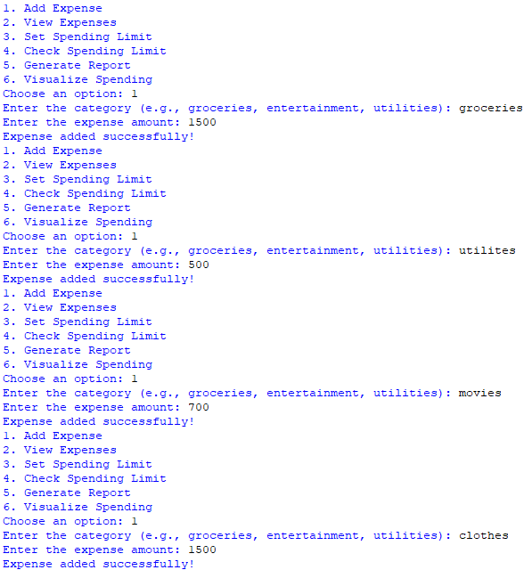
ADDING EXPENSES
Users can easily add new expenses by selecting option 1 from the main menu.
The application prompts users to enter the expense category & amount.
Once the information is provided, the expenses is added to the user’s spending history.

Slide 8
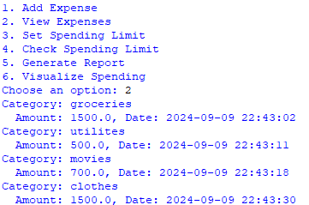
VIEWING EXPENSES
By selecting option 2, users can view a detailed list of their recorded expenses.
The list includes the category, amount, & data for each expense.
This feature provides a clear overview of spending habits & helps users identity areas for improvement.

Slide 9
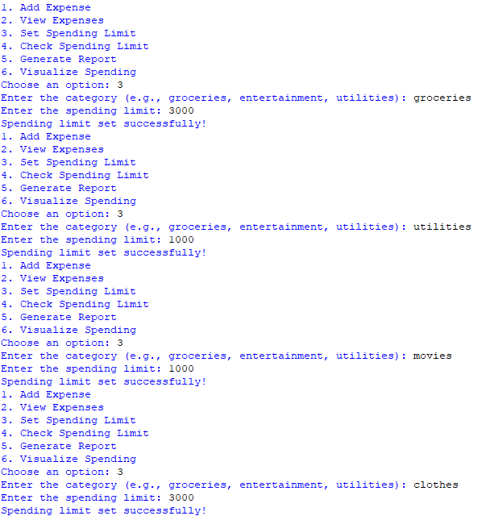
SET SPENDING LIMITS
Users can set spending limits for specific categories to manage their finances effectively.
By selecting option 3, users are prompted to enter the category and desired spending limit.
This feature helps users stay within their budget & avoid overspending.

Slide 10
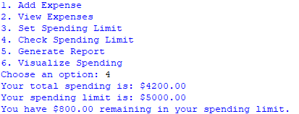
CHECK SPENDING LIMITS
By selecting option 4, users can view their current spending in relation to their set limits.
The application displays the total spending limit, & remaining balance.
This feature helps users stay informed about their financial status & make adjustments as needed.

Slide 11
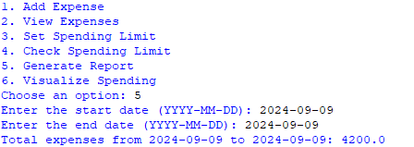
SET SPENDING LIMITS
By selecting option 5, users can generate detailed reports of their spending within a specified date range.
This application prompts users to enter the start and end dates for the report.
The generated report provides a summary of total expenses during the selected period.

Slide 12
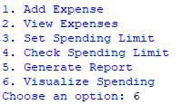
VISUALIZE SPENDING
By selecting option 6, users can visualize their spending trends in a clear & informative way.
The chart displays the total spending for each category, allowing users to easily compare & identify spending patterns.
This visual representation provides valuable insights into financial habits & help users make data driven decision.

Slide 13
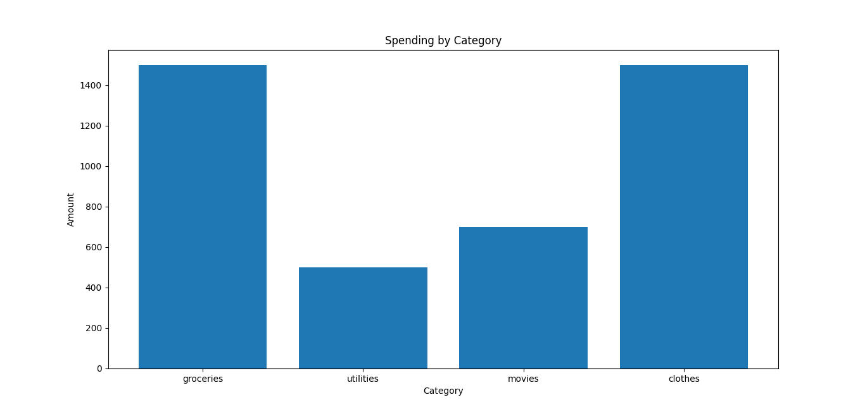

Slide 14
CONCLUSION
This project provides a comprehensive tool for tracking and analyzing personal spending habits.
Key features include custom categories, spending limits, and data visualization.
By using this tool, users gain valuable insights, identify areas to cut back, and achieve their financial goals, ultimately taking control of their financial well-being.

Slide 15
THANK YOU

